Slide 1
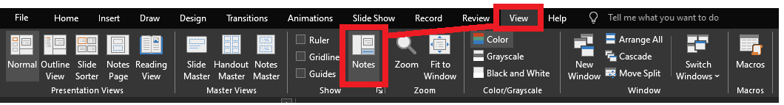
Reviewing after the presentation?
Be sure to enable the Notes for slide-specific content

Slide 2


The T-SQL PIV T Operators
https://github.com/jbfoushee/MyPresentations/

Slide 3

SQL Server “MAZSQLWPS001”
Primary Contact: Jeff
Secondary Contact: Ann
ServerName | PropertyName | PropertyValue
MAZSQLWPS001 | Primary Contact | Jeff
MAZSQLWPS001 | Secondary Contact | Ann
ServerName | Primary Contact | Secondary Contact
MAZSQLWPS01 | Jeff | Ann
One piece of truth per line
Horizontal data: New contacts added as rows
Better-suited for data storage
One piece of truth per x/y position
Vertical data: New contacts added as columns
Better-suited for reporting
Notes:
I am part-owner of a server named MAZSQLWPS001, and this needs to be documented as data inside some database.

Slide 4
ServerName | PropertyName | PropertyValue
MAZSQLWPS001 | Primary Contact | Jeff
MAZSQLWPS001 | Secondary Contact | Ann
ServerName | Primary Contact | Secondary Contact
MAZSQLWPS01 | Jeff | Ann
There will be times where your data must be converted:
A feed you import does not fit into your model
Data you export does not fit into the target model
Data summarization, reporting
Notes:
The real world does not conform to the same standards on storing data.
Data may need to be transformed to meet disparate business requirements, or to summarize

Slide 5


Jeff Foushee
(Louisville, KY)
SQL Server Database Admin
Programmer
SQL Saturday speaker
Blackjack dealer

Slide 6
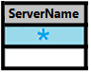
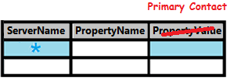
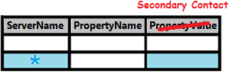
Converting Vertical Data to Horizontal
ServerName | PropertyName | PropertyValue
MAZSQLWPS001 | Primary Contact | Jeff
MAZSQLWPS001 | Secondary Contact | Ann
ServerName | Primary Contact | Secondary Contact
MAZSQLWPS001 | Jeff | Ann
SELECT base.ServerName AS ServerName
, pri.PropertyValue AS [Primary Contact]
, sec.PropertyValue AS [Secondary Contact]
FROM
( SELECT DISTINCT ServerName
FROM [Table1]
) base
FULL OUTER JOIN
( SELECT ServerName, PropertyValue
FROM [Table1]
WHERE PropertyName = 'Primary Contact'
) pri
ON base.ServerName = pri.ServerName
FULL OUTER JOIN
( SELECT ServerName, PropertyValue
FROM [Table1]
WHERE PropertyName = 'Secondary Contact'
) sec
ON base.ServerName = sec.ServerName
Notes:
Let’s take a look at taking vertical data and turn it horizontal.
This could be accomplished using FULL OUTER JOINs
For each unique value in the PropertyName column, a new FULL OUTER JOIN is required
This is fine for a small number of columns…

Slide 7
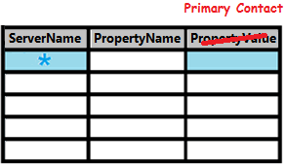
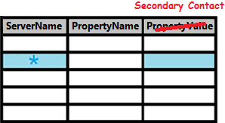
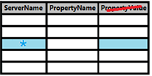
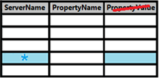

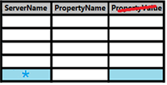
Converting Vertical Data to Horizontal
ServerName | PropertyName | PropertyValue
MAZSQLWPS001 | Primary Contact | Jeff
MAZSQLWPS001 | Secondary Contact | Ann
MAZSQLWPS001 | Tertiary Contact | Chris
MAZSQLWPS001 | Access Approver | Dan
MAZSQLWPS001 | Patching Approver | Joanne
ServerName | Primary… | Secondary… | Tertiary… | Access… | Patching…
MAZSQLWPS001 | Jeff | Ann | Chris | Dan | Joanne
SELECT base.ServerName AS ServerName
, pri.PropertyValue AS [Primary Contact]
, sec.PropertyValue AS [Secondary Contact]
, tri.PropertyValue AS [Tertiary Contact]
, access.PropertyValue AS [Access Approver]
, patch.PropertyValue AS [Patching Approver]
FROM
( SELECT DISTINCT ServerName FROM [Table1]) base
FULL OUTER JOIN
( SELECT ServerName, PropertyValue FROM [Table1] WHERE PropertyName = 'Primary Contact') pri
ON base.ServerName = pri.ServerName
FULL OUTER JOIN
( SELECT ServerName, PropertyValue FROM [Table1] WHERE PropertyName = 'Secondary Contact') sec
ON base.ServerName = sec.ServerName
FULL OUTER JOIN
( SELECT ServerName, PropertyValue FROM [Table1] WHERE PropertyName = Tertiary Contact') tri
ON base.ServerName = tri.ServerName
FULL OUTER JOIN
( SELECT ServerName, PropertyValue FROM [Table1] WHERE PropertyName = Access Approver') access
ON base.ServerName = access.ServerName
FULL OUTER JOIN
( SELECT ServerName, PropertyValue FROM [Table1] WHERE PropertyName = Patching Approver') patch
ON base.ServerName = patch.ServerName
Notes:
But what about when new requirements are added?
The code gets pretty unreadable.
There must be an easier way!

Slide 8

Notes:
What if I told you that Microsoft has already provided a way to make this easier?
And thankfully, there is no additional product you have to buy.

Slide 9


What is a pivot?
A pivot is a point or set of points, on the end of which
something rests and turns
something rotates or oscillates.
http://dictionary.reference.com/browse/pivoted?s=t
Notes:
A pivot is a theoretical point or set of points that stay stationary while something rotates or spins about it.
Some example motions are a see-saw, a door hinge,

Slide 10

Torque / Force
Pivot
Notes:
The example of the wrench turning a bolt will be used for demonstrative purposes against data.

Slide 11



“Imagine” how this would apply to data
Less rows, more columns
Vertical data
Horizontal data
Notes:
In this oversimplified demonstration, what if I could take a wrench and rotate that data?
Look how we get more columns, and fewer rows.
This is not quite the result, but the rotation will be helpful to explain later.

Slide 12
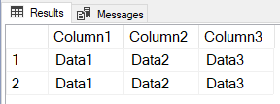
The PIVOT operator promotes data to column headers
Notes:
We’ll depict the PIVOT as a clockwise function to further describe this passage.
In every dataset, there is a box that represents neither a row header nor a column header… but it borders both columns and data.
Any data that will become a column header has to pass though the “magic square” to transcend functionality.
Coincidentally, the letter “P” is generally written using a clockwise circle.

Slide 13
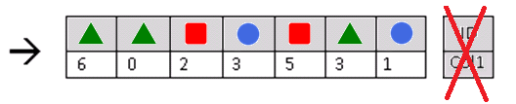
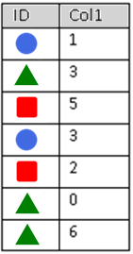
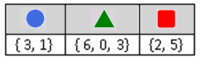
How a PIVOT works on data
But what is ultimately presented back to the client?
Notes:
Let’s look at some basic arbitrary data.
The PIVOT operator takes the data and turns it clockwise, causing data to promote to the column headers. The original column headers are removed.
However, the rotated dataset is invalid because it uses repeating column headers.
To solve this, the data is temporarily condensed into “holding tanks” by column.
But what is ultimately presented back to the client?

Slide 14
An aggregates refresher
An aggregate value is a solitary value that summarizes a list of values, even a list of one
Aggregate | Alphanumerics | Dates | Numerics | Datarows with NULLs | NULL-only records, or record-less
COUNT() | þ | þ | þ | Not counted towards final result | 0
COUNT_BIG() | þ | þ | þ | Not counted towards final result | 0
MIN() | þ | þ | þ | Not counted towards final result | NULL
MAX() | þ | þ | þ | Not counted towards final result | NULL
SUM() |  |  | þ | Not counted towards final result | NULL
AVG() |  |  | þ | Not counted towards final result | NULL
See Books Online for additional aggregates, as well as any aggregate-to-datatype limitations.
Notes:
You must use an aggregate function, even if you have one value to aggregate.
Make sure your alphanumeric data is scrubbed before applying aggregates upon it.
Min/Max are usually not adequate aggregates for alphanumerics, e.g. a list of names, so make ensure you don’t have multiple values.

Slide 15
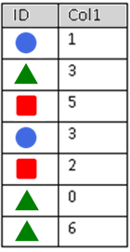

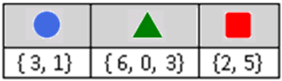
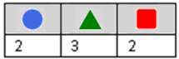
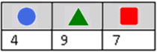
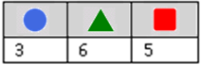
PIVOT
<AGG>([Col1])
FOR [ID] IN ( , , )
PIVOT
COUNT([Col1])
FOR [ID] IN ( , , )
PIVOT
SUM([Col1])
FOR [ID] IN ( , , )
PIVOT
MAX([Col1])
FOR [ID] IN ( , , )
Notes:
This syntax is the main part of understanding the PIVOT statement.
Cannot stress this enough: Because values are aggregated, you get one and only one resulting value.
You cannot result with the raw array or list.

Slide 16



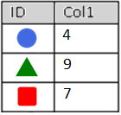
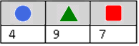
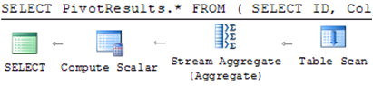
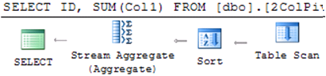
PIVOT() LIKE/!= GROUP BY
PIVOT
GROUP BY
SELECT PivotResults.*
FROM (
SELECT ID, Col1
FROM dbo.Table_1
) AS RawData
PIVOT (
SUM(Col1)
FOR [ID]
IN ([ ],[ ],[ ])
) AS PivotResults
SELECT ID
, SUM(Col1) AS Col1
FROM dbo.Table_1
GROUP BY ID
Notes:
While both the PIVOT and GROUP BY clauses aggregate results, they do not share the same output structure, nor the same execution plan.

Slide 17

Breakdown of PIVOT statement (1/4)
Exactly one aggregate can be applied
Exactly one column can be aggregated
PIVOT (
SUM(Col1)
FOR [ID]
IN ([Circle], [Triangle], [Square])
)
Exactly one column’s values can be
promoted into the column header
Table_1
PivotResults
Each “value-turned-column” (VTC)
Must be explicitly requested at compile-time:
Once. Repeated times will result in a parse error
Sub-queries and variables are not allowed here
“But what if I don’t know them at compile-time?” Stay tuned
Strong recommendation to enclose in braces
Notes:
These rules apply to each PIVOT clause. You can re-PIVOT a PIVOTed statement, though I personally have yet to find a valid case study for this.
Microsoft calls them “pivoted columns,” but I will use “Values-Turned-Columns”
The glossary term “VTC” will be used elsewhere.

Slide 18
Breakdown of PIVOT statement (2/4)
SELECT
FROM (
SELECT ID, Col1 FROM dbo.Table_1
)
PIVOT (
SUM(Col1)
FOR [ID]
IN ([Circle], [Triangle], [Square])
)
Original dataset
Table_1
PivotResults
Notes:
The original dataset is the one you want to index for

Slide 19
Breakdown of PIVOT statement (3/4)
SELECT
FROM (
SELECT ID, Col1 FROM dbo.Table_1
) AS RawData
PIVOT (
SUM(Col1)
FOR [ID]
IN ([Circle], [Triangle], [Square])
) AS PivotResults
Table_1
Both predicates must be named
PivotResults
Notes:
I use “RawData” and “PivotResults” to identify my predicates easily, but you can use any name.

Slide 20
Breakdown of PIVOT statement (4/4)
SELECT PivotResults.*
FROM (
SELECT ID, Col1 FROM dbo.Table_1
) AS RawData
PIVOT (
SUM(Col1)
FOR [ID]
IN ([Circle], [Triangle], [Square])
) AS PivotResults
Table_1
And then select the correct predicate
PivotResults
You cannot directly select values from this predicate
Notes:
And select the correct predicate.
Congrats, you have transformed the dataset provided by “RawData” into a new dataset named “PivotResults.”
You cannot explicitly request any columns from RawData into the SELECT predicate.
You don’t have to qualify the * with “PivotResults”

Slide 21
Demo
2-column PIVOT

Slide 22
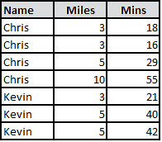
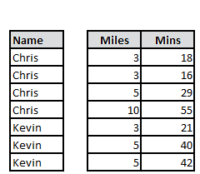
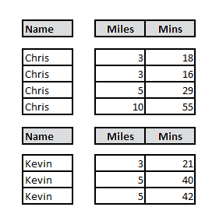
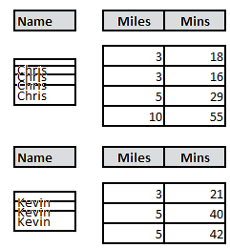
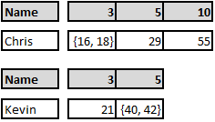
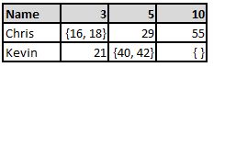
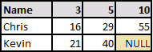
How a 3-column PIVOT works…
SELECT PivotResults.*
FROM (
SELECT [Name], Miles, Mins FROM ...
) AS RawData
PIVOT (
MIN(Mins)
FOR [Miles]
IN ([3], [5], [10])
) AS PivotResults

Slide 23
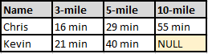
SELECT PivotResults.*
FROM (
SELECT [Name], Miles, Mins
FROM ...
) AS RawData
PIVOT (
MIN(Mins)
FOR [Miles]
IN ([3], [5], [10])
) AS PivotResults
SELECT PivotResults.[Name]
, PivotResults.[3]
, PivotResults.[5]
, PivotResults.[10]
SELECT PivotResults.[Name]
, CONVERT(varchar, PivotResults.[3]) + ' min' AS [3-mile]
, CONVERT(varchar, PivotResults.[5]) + ' min' AS [5-mile]
, CONVERT(varchar, PivotResults.[10])+ ' min' AS [10-mile]

Slide 24
StoreID | [Quarter] | [Year] | Sales |  | DataEnteredBy
1 | 1 | 20XX | 10000 |  | Mary
1 | 2 | 20XX | 15000 |  | Chris
1 | 3 | 20XX | 17500 |  | Mary
1 | 4 | 20XX | 18000 |  | Mary
1 | 1 | 20XY | 22000 |  | Chris
1 | 2 | 20XY | 35000 |  | Bob
1 | 3 | 20XY | 40000 |  | Chris
1 | 4 | 20XY | 60000 |  | Mary
1 | 1 | 20XZ | 38000 |  | Mary
1 | 2 | 20XZ | 32000 |  | Chris
1 | 3 | 20XZ | 45000 |  | Bob
1 | 4 | 20XZ | 50000 |  | Chris
2 | 1 | 20XY | 20000 |  | Kim
2 | 2 | 20XY | 15000 |  | Kim
2 | 3 | 20XY | 30000 |  | Kim
2 | 4 | 20XY | 8000 |  | Lee
2 | 1 | 20XZ | -3000
3 | 2 | 20XZ | 50000 |  | Jerry
3 | 3 | 20XZ | 30000 |  | Jerry
3 | 4 | 20XZ | 50000 |  | Bill

Slide 25
Demo
3-column PIVOT

Slide 26
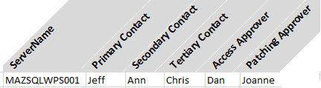


ServerName | PropertyName | PropertyValue
MAZSQLWPS001 | Primary Contact | Jeff
MAZSQLWPS001 | Secondary Contact | Ann
MAZSQLWPS001 | Tertiary Contact | Chris
MAZSQLWPS001 | Access Approver | Dan
MAZSQLWPS001 | Patching Approver | Joanne
The FULL OUTER JOIN method…
The PIVOT method…
SELECT base.ServerName AS ServerName
, pri.PropertyValue AS [Primary Contact]
, sec.PropertyValue AS [Secondary Contact]
, tri.PropertyValue AS [Tertiary Contact]
, access.PropertyValue AS [Access Approver]
, patch.PropertyValue AS [Patching Approver]
FROM
( SELECT DISTINCT ServerName FROM [Table1]
) base
FULL OUTER JOIN
( SELECT ServerName, PropertyValue FROM [Table1] WHERE PropertyName = 'Primary Contact'
) pri
ON base.ServerName = pri.ServerName
FULL OUTER JOIN
( SELECT ServerName, PropertyValue FROM [Table1] WHERE PropertyName = 'Secondary Contact'
) sec
ON base.ServerName = sec.ServerName
FULL OUTER JOIN
( SELECT ServerName, PropertyValue FROM [Table1] WHERE PropertyName = Tertiary Contact'
) tri
ON base.ServerName = tri.ServerName
FULL OUTER JOIN
( SELECT ServerName, PropertyValue FROM [Table1] WHERE PropertyName = Access Approver'
) access
ON base.ServerName = access.ServerName
FULL OUTER JOIN
( SELECT ServerName, PropertyValue FROM [Table1] WHERE PropertyName = Patching Approver'
) patch
ON base.ServerName = patch.ServerName
SELECT PivotResults.*
FROM (
SELECT ServerName
, PropertyName
, PropertyValue
FROM [Table1]
) AS RawData
PIVOT (
MAX(PropertyValue)
FOR [PropertyName]
IN ([Primary Contact]
, [Secondary Contact]
, [Tertiary Contact]
, [Access Approver]
, [Patching Approver])
) AS PivotResults
Notes:
So back to our original example, which is a 3-column PIVOT
As long as I’m guaranteed one value per contact type

Slide 27
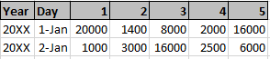
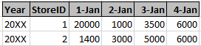
How do I manage my VTCs? (1/4)
Option 1: Don’t. Pivot for items that never grow, or grow slowly over time.
PIVOT (
SUM(Sales)
FOR [StoreID]
IN ([1], [2], [3],
[4], [5])
)
This:
Not This:
PIVOT (
SUM(Sales)
FOR [Day]
IN ([1-Jan], [2-Jan],
[3-Jan], [4-Jan],
[5-Jan] , ...)
)
…
…
…
Supported by ad-hoc queries
Supported by stored procedures
Supported by views

Slide 28
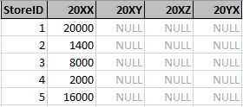
How do I manage my VTCs? (2/4)
Option 2: Explicitly request the ones of interest; Provision for future extras
PIVOT (
SUM(Sales)
FOR [Year]
IN ([20XX],
[20XY],
[20XZ],
[20YX]
)
Supported by ad-hoc queries
Supported by stored procedures
Supported by views

Slide 29
How do I manage my VTCs? (3/4)
Option 3: Use dynamic SQL
DECLARE @_VTCNames varchar(MAX); SET @_VTCNames = ''
Option 3a: Cursor-based
Option 3b: STUFF + FOR XML (SQL 2005+)
DECLARE Cursor_VTCNames CURSOR LOCAL FAST_FORWARD FOR
SELECT DISTINCT [Year] FROM ... ORDER BY [Year]
DECLARE @_$variable varchar(50)
DECLARE @_rowcount integer; SET @_rowcount = 0
OPEN Cursor_VTCNames
FETCH NEXT FROM Cursor_VTCNames INTO @_$variable
WHILE @@FETCH_STATUS = 0
BEGIN
SET @_rowcount += 1
IF @_rowcount > 1 SET @_VTCNames = @_VTCNames + ','
SET @_VTCNames = @_VTCNames + '[' + @_$variable + ']'
FETCH NEXT FROM Cursor_VTCNames INTO @_$variable
END
CLOSE Cursor_VTCNames; DEALLOCATE Cursor_VTCNames
SET @_VTCNames = STUFF(
(
SELECT ', [' + [Year] + ']'
FROM ( SELECT DISTINCT [Year] FROM ... ) AS T
ORDER BY [Year]
FOR XML PATH(''), TYPE
).value('(./text())[1]','varchar(MAX)'),1,2,'');
Option 3c: STRING_AGG function (SQL 2017+)
SELECT @_VTCNames =
CONCAT('[', STRING_AGG([Year], '],['), ']')
FROM
(SELECT DISTINCT [Year] FROM ...
ORDER BY [Year]
) a
Notes:
Essentially, you’ll be constructing the PIVOT’s IN-clause.
You want to order the columns into a logical order, and only look for unique data
Many thanks to MSDN forums for the XML conversion technique:
http://social.msdn.microsoft.com/Forums/sqlserver/en-US/2ab88114-be39-40f7-bed0-99d30b6fbc43/set-variable-to-distinct-array-returned-by-for-xml?forum=transactsql

Slide 30
How do I manage my VTCs? (4/4)
Option 3 (cont.): Use dynamic SQL
DECLARE @_VTCNames varchar(MAX); SET @_VTCNames = ''
-- Load your @_VTCNames variable using an option from previous slide
DECLARE @_SQLStmt varchar(MAX); SET @_SQLStmt = ''
SET @_SQLStmt = @_SQLStmt + ' SELECT PivotResults.* '
SET @_SQLStmt = @_SQLStmt + ' FROM ( ... ) AS RawData '
SET @_SQLStmt = @_SQLStmt + ' PIVOT ( '
SET @_SQLStmt = @_SQLStmt + ' SUM(Sales) '
SET @_SQLStmt = @_SQLStmt + ' FOR [Year] '
SET @_SQLStmt = @_SQLStmt + ' IN (' + @_VTCNames + ')'
SET @_SQLStmt = @_SQLStmt + ' ) AS PivotResults'
SET @_SQLStmt = @_SQLStmt + ' ORDER BY 1 ASC; '
EXEC(@_SQLStmt)
Ensures the first column is sorted, regardless of datatype
Supported by ad-hoc queries
Supported by stored procedures
Not supported by views
Notes:
Essentially, you’ll be constructing the PIVOT’s IN-clause.
You want to order the columns into a logical order, and only look for unique data

Slide 31
Demo
Dynamic PIVOT

Slide 32
The n-column PIVOT

Slide 33
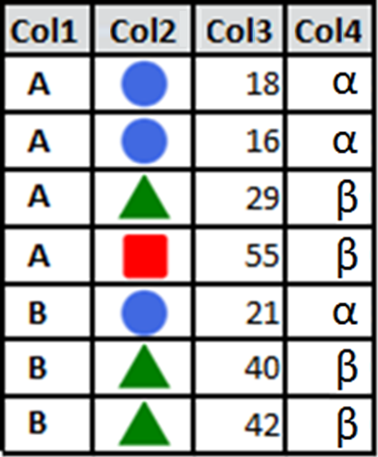
How a n-column PIVOT works…
SELECT PivotResults.*
FROM (
SELECT Col1, Col2, Col3, Col4
FROM ...
) AS RawData
PIVOT (
SUM(Col3)
FOR [Col2]
IN ( , , )
) AS PivotResults
Notes:
Advanced explanation of the PIVOT
RawData should hold data related to the outcome of the input. For our marathon demo: name, maybe weather, what they ate…
Not who entered the data
(This is why that last query in the 3-column pivot acted bizarre and gave us this format of output. What we wanted was a “lookup,” which we’ll discuss later.)

Slide 34
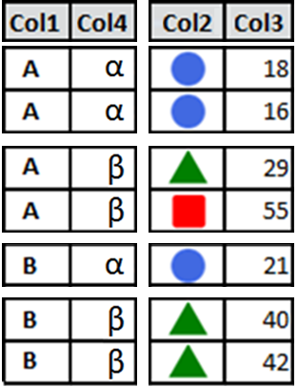
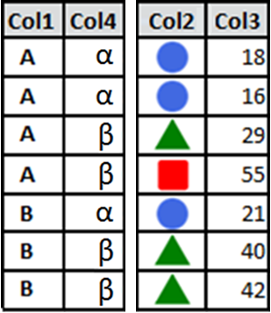
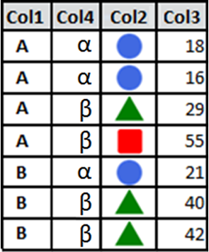

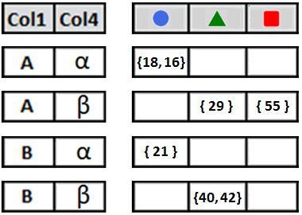
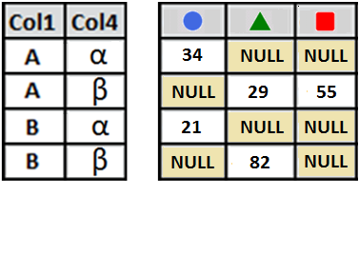
How a n-column PIVOT works…
Non-pivots ← → Pivoted columns
SELECT PivotResults.*
FROM (
SELECT Col1, Col2, Col3, Col4
FROM ...
) AS RawData
PIVOT (
SUM(Col3)
FOR [Col2]
IN ( , , )
) AS PivotResults
Horizontal separation of “DISTINCT” combos
Notes:
Advanced explanation of the PIVOT
RawData should hold data related to the outcome of the input. For our marathon demo: name, maybe weather, what they ate…
Not who entered the data
(This is why that last query in the 3-column pivot acted bizarre and gave us this format of output. What we wanted was a “lookup,” which we’ll discuss later.)

Slide 35
Random extra PIVOT trivia…

Slide 36

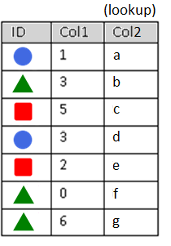
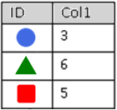
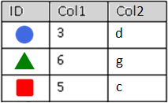

The “ugly” of PIVOT… lookups
PIVOT
GROUP BY
SELECT PivotResults.*
FROM (
SELECT ID, Col1
FROM dbo.Table_1
) AS RawData
PIVOT (
MAX(Col1)
FOR [ID]
IN ([ ],[ ],[ ])
) AS PivotResults
SELECT ID
, MAX(Col1) AS Col1
FROM dbo.Table_1
GROUP BY ID
Notes:
I want you to be informed, so I need to show you the ugly side of the PIVOT statement, in managing lookups.
I will use the GROUP BY slide from earlier, but the scenario is as follows:
I want the MAX of Col1, grouped by ID, but the associated Col2 value with it
For instance, Louisville played Kentucky in a game of sportsball last night. I have the teams, players, and points each participant contributed.
I want to build a pivot table of the most points contributed by each team.

Slide 37

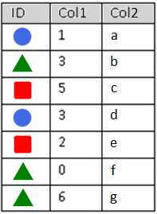
The “ugly” of PIVOT… lookups
PIVOT
GROUP BY
SELECT PivotResults.*
FROM (
SELECT ID, Col1
FROM dbo.Table_1
) AS RawData
PIVOT (
MAX(Col1)
FOR [ID]
IN ([ ],[ ],[ ])
) AS PivotResults
SELECT orig.ID
, orig.Col1
, orig.Col2
FROM dbo.Table_1 orig
INNER JOIN
( SELECT ID, MAX(Col1) AS Col1
FROM dbo.Table_1
GROUP BY ID
) maxes
ON orig.ID = maxes.ID
AND orig.Col1 = maxes.Col1
INNER JOIN dbo.Table_1
ON ?????
Notes:
I can do this fairly easily with the GROUP BY statement, but how to do this with the PIVOT?
It’s not like I can join the PivotResults back to Table_1; the columns don’t even match.

Slide 38

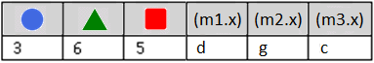
The “ugly” of PIVOT… lookups
PIVOT
GROUP BY
SELECT PivotResults.*
, m1.x, m2.x, m3.x
FROM (
SELECT ID, Col1
FROM dbo.Table_1
) AS RawData
PIVOT (
MAX(Col1)
FOR [ID]
IN ([ ],[ ],[ ])
) AS PivotResults
CROSS JOIN
( SELECT MAX(Col1) AS x
FROM dbo.Table_1 WHERE ID = ) m1
CROSS JOIN
( SELECT MAX(Col1) AS x
FROM dbo.Table_1 WHERE ID = ) m2
CROSS JOIN
( SELECT MAX(Col1) AS x
FROM dbo.Table_1 WHERE ID = ) m3
SELECT orig.ID
, orig.Col1
, orig.Col2
FROM dbo.Table_1 orig
INNER JOIN
( SELECT ID, MAX(Col1) AS Col1
FROM dbo.Table_1
GROUP BY ID
) maxes
ON orig.ID = maxes.ID
AND orig.Col1 = maxes.Col1
Notes:
I can do a CROSS JOIN against the original table, but I have to do one for each distinct VTC. And then circularly, how many VTCs are there?

Slide 39


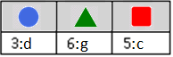
The “ugly” of PIVOT… lookups
PIVOT
GROUP BY
SELECT PivotResults.*
FROM (
SELECT orig.ID
, CONCAT(orig.Col1, ':', orig.Col2)
AS Caption
FROM dbo.Table_1 orig
INNER JOIN
( SELECT ID, MAX(Col1) AS Col1
FROM dbo.Table_1
GROUP BY ID
) maxes
ON orig.ID = maxes.ID
AND orig.Col1 = maxes.Col1
) AS RawData
PIVOT (
MAX(Caption)
FOR [ID]
IN ([ ],[ ],[ ])
) AS PivotResults
SELECT orig.ID
, orig.Col1
, orig.Col2
FROM dbo.Table_1 orig
INNER JOIN
( SELECT ID, MAX(Col1) AS Col1
FROM dbo.Table_1
GROUP BY ID
) maxes
ON orig.ID = maxes.ID
AND orig.Col1 = maxes.Col1
Notes:
In this example, I take the entire query of the GROUP BY as the query of the RawContents.
I merge Col1 and Col2 into a character-separated Caption, and then PIVOT the caption.
On the outer SELECT, I can parse the caption with CHARINDEX functions.

Slide 40
Demo (on your own time)
PIVOT lookups

Slide 41
One more limitation of the PIVOT
PIVOT (
SUM(Col1)
FOR [ID]
IN ([Circle], [Triangle], [Square])
)
ü
û
û
û
û
SUM(Col1)
SUM(Col1 * 10)
SUM(Col1) * 10
SUM(IsNull(Col1, 12))
SUM(CASE WHEN Col1 > 1000 THEN Col1 ELSE 0 END)
Notes:
Aggregate, Column, full-stop.
No calculations, no functions, no logic.
I left this at the end because this should be the least of your worries at this point.
All of these can be satisfied by SELECT/WHERE conditions in RawData. In some cases, the outer SELECT clause as well.

Slide 42

Questions about the PIVOT operator?
Coming up next → The UNPIV T operator…

Slide 43
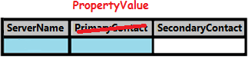
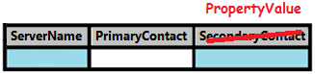
Converting Horizontal Data to Vertical
ServerName | Primary Contact | Secondary Contact
MAZSQLWPS01 | Jeff | Ann
ServerName | PropertyName | PropertyValue
MAZSQLWPS001 | Primary Contact | Jeff
MAZSQLWPS001 | Secondary Contact | Ann
SELECT ServerName
, 'Primary Contact' AS PropertyName
, [Primary Contact] AS PropertyValue
FROM [Table2]
UNION ALL
SELECT ServerName
, 'Secondary Contact' AS PropertyName
, [Secondary Contact] AS PropertyValue
FROM [Table2]
+
UNION ALL...
UNION ALL...
Notes:
How could I take horizontal data and change it to vertical data?
Note that the data is going in the reverse direction.
One idea would be the UNION ALL statement.
Notice for each column on the right-hand dataset, I need another UNION ALL statement.

Slide 44
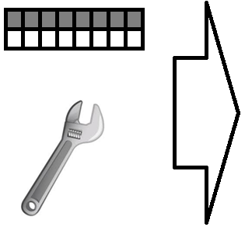

“Imagine” how this would apply to data
More rows, less columns
Horizontal data
Vertical data
Notes:
In this oversimplified demonstration, what if I could take a wrench and rotate that data?
Look how we get less columns, and more rows.
This is not quite the result, but the rotation will be helpful to explain later.

Slide 45
An UNPIVOT demotes column headers into data
Notes:
For column headers to transcend to data elements, they need to move counter-clockwise though the magic square.
The curve of the letter “U” is written counter-clockwise as well (reminds you which operation to use based on rotation).

Slide 46
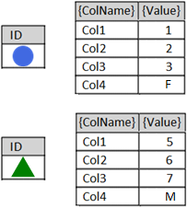





How an UNPIVOT works
…
Datatype?
Notes:
Let’s say Col1, Col2, and Col3 are tinyints, and Col4 is a one-character string.
After the animation, what datatype would satisfy the merged values?

Slide 47
The Lowest Common Denominator
All run-time values merged by UNPIVOT must be able to fit in one common datatype without overflow (range of values), truncation (length of values), or collation (unicode / case-sensitivity) issues.
Col1 = int
Col2 = bigint
Resulting {Value} column may need to be defined as bigint
Col1 = int
Col2 = bigint
Col3 = varchar(10)
Resulting {Value} column may need to be varchar(20)
Col1 = int
Col2 = bigint
Col3 = varchar(50)
Col4 = nchar(2000)
or smaller…
Resulting {Value} column may need to be
nvarchar(2000)
Notes:
Balance your current/future needs such that your common datatype continues to work, yet doesn’t bloat tempdb with unnecessary sizes.
Consider the theoretical minimums/maximums of the combined datatypes.
(A bigint could have a value of 9 quintillion which is 19 characters long when typed out. Add one more character for the negative sign.)
But if you’re not using extremes in your data (datatype maximums/minimums/lengths), could you go even smaller?

Slide 48

Breakdown of UNPIVOT statement (1/5)
Table_1
UNPIVOT (
PropertyValue
FOR PropertyName
IN ([Col1], [Col2], [Col3], [Col4])
)
Brackets required only when column name contains spaces
UnpivotResults
Decide on new column names
These represent the key/value pairs to be returned
Notes:
Your new {ColName} and {Value} columns could be as simple as ‘PropertyName’ and ‘PropertyValue’

Slide 49
Breakdown of UNPIVOT statement (2/5)
Table_1
SELECT
FROM (
SELECT ID
, Col1
, Col2
, Col3
, Col4
FROM dbo.Table_1
)
UNPIVOT (
PropertyValue
FOR PropertyName
IN ([Col1], [Col2], [Col3], [Col4])
)
Original dataset
tinyint
UnpivotResults
char(1)
Notes:
Add my original dataset… oh yeah, but these datatypes clash.
What datatype do I need such that the data gets along?
Have I reviewed past, present and future values?
Am I storing this for personal use, or am I going to redirect programs to come get their data here?

Slide 50
Breakdown of UNPIVOT statement (3/5)
Table_1
SELECT
FROM (
SELECT ID
, Convert(char(3),Col1)
, Convert(char(3),Col2)
, Convert(char(3),Col3)
, Convert(char(3),Col4)
FROM dbo.Table_1
)
UNPIVOT (
PropertyValue
FOR PropertyName
IN ([Col1], [Col2], [Col3], [Col4])
)
Convert to common
datatypes as necessary
AS Col1
AS Col2
AS Col3
AS Col4
UnpivotResults
Re-alias column name to itself,
for the UNPIVOT mappings to work
Notes:
I have decided that I want a char(3) conversion.
Once I use a Convert function on a value, the column’s name is lost.
I have to use the AS clause to re-establish the mapping between the original query and UNPIVOT’s IN-clause

Slide 51
Breakdown of UNPIVOT statement (4/5)
Table_1
SELECT
FROM (
SELECT ID
, Convert(char(3),Col1) AS Col1
, Convert(char(3),Col2) AS Col2
, Convert(char(3),Col3) AS Col3
, Convert(char(3),Col4) AS Col4
FROM dbo.Table_1
) AS RawData
UNPIVOT (
PropertyValue
FOR PropertyName
IN ([Col1], [Col2], [Col3], [Col4])
) AS UnpivotResults
UnpivotResults
Both predicates must be named
Notes:
Both predicates must be named with something

Slide 52
Breakdown of UNPIVOT statement (5/5)
Table_1
SELECT UnpivotResults.*
FROM (
SELECT ID
, Convert(char(3),Col1) AS Col1
, Convert(char(3),Col2) AS Col2
, Convert(char(3),Col3) AS Col3
, Convert(char(3),Col4) AS Col4
FROM dbo.Table_1
) AS RawData
UNPIVOT (
PropertyValue
FOR PropertyName
IN ([Col1], [Col2], [Col3], [Col4])
) AS UnpivotResults
UnpivotResults
And select the correct predicate
Notes:
Do I have to preface the star with UnpivotResults? No.

Slide 53


But what if there were NULLs in the data?
Table_1
?
SELECT *
FROM (
SELECT ID
, Convert(char(3),Col1) AS Col1
, Convert(char(3),Col2) AS Col2
, Convert(char(3),Col3) AS Col3
, Convert(char(3),Col4) AS Col4
FROM dbo.Table_1
) AS RawData
UNPIVOT (
PropertyValue
FOR PropertyName
IN ([Col1], [Col2], [Col3], [Col4])
) AS UnpivotResults
UnpivotResults
Notes:
When we look at the demo, we’ll find the “{Circle, Col3, NULL}” and “{Triangle, Col2, NULL}” records do not transfer to the UnpivotResults recordset.
You can force these records into the resultset by using the IsNull function to display some alternate text.
However, your alternate text will also be bound by the lowest common denominator rule from 6 slides ago.

Slide 54
Demo
UNPIVOT operator

Slide 55

The XML-based unpivot
DECLARE @MyString varchar(20) = '1 2 3 4 5'
DECLARE @MyString_XML XML
= CAST(
'<root><item>'
+ Replace(@MyString, ' ', '</item><item>')
+ '</item></root>'
AS XML)
SELECT t.value('.', 'varchar(max)') AS blah
FROM @MyString_XML.nodes('//root/item') AS a(t)

Slide 56

Time for a level-set….
(level set)

Slide 57
CROSS APPLY
Notes:
Let’s talk about CROSS APPLY

Slide 58
CROSS JOIN
Not a JSON function. Makes a cartesian product of the rows between two tables
SELECT *
FROM dbo.Table_1
CROSS JOIN dbo.Table_2
Table_1
Column1 | Column2
1_1_1 | 1_1_2
1_2_1 | 1_2_2
Column1 | Column2 | ColumnX | ColumnY | ColumnZ
1_1_1 | 1_1_2 | 2_1_X | 2_1_Y | 2_1_Z
1_1_1 | 1_1_2 | 2_2_X | 2_2_Y | 2_2_Z
1_2_1 | 1_2_2 | 2_1_X | 2_1_Y | 2_1_Z
1_2_1 | 1_2_2 | 2_2_X | 2_2_Y | 2_2_Z
Table_2
ColumnX | ColumnY | ColumnZ
2_1_X | 2_1_Y | 2_1_Z
2_2_X | 2_2_Y | 2_2_Z
(ANSI-standard SQL)

Slide 59

CROSS JOIN
Not a JSON function. Makes a cartesian product of the rows between two tables
Table_1
Table_2
Column1 | Column2
1_1_1 | 1_1_2
1_2_1 | 1_2_2
ColumnX | ColumnY | ColumnZ
2_1_X | 2_1_Y | 2_1_Z
2_2_X | 2_2_Y | 2_2_Z
Isolate the first row of Table_1 versus Table_2
Column1 | Column2 | ColumnX | ColumnY | ColumnZ
1_1_1 | 1_1_2 | 2_1_X | 2_1_Y | 2_1_Z
1_1_1 | 1_1_2 | 2_2_X | 2_2_Y | 2_2_Z
Isolate the second row of Table_1 versus Table_2
Column1 | Column2 | ColumnX | ColumnY | ColumnZ
1_2_1 | 1_2_2 | 2_1_X | 2_1_Y | 2_1_Z
1_2_1 | 1_2_2 | 2_2_X | 2_2_Y | 2_2_Z
Notes:
We can take away from the CROSS JOIN that “for each” row in Table1, we get rows of Table2

Slide 60

CROSS APPLY
Not a PIVOT function. Acquires a subset of data for each row found by the outer query. Behaves like an INNER JOIN: if no subset if found, the outer row disappears from the result set.
SELECT c.*, o.*
FROM Customers c
INNER JOIN Orders o
ON c.CustomerID = o.CustomerID
INNER JOIN
( SELECT CustomerID
, MAX(OrderDate) AS OrderDate
FROM Orders
GROUP BY CustomerID
) latest1
ON o.CustomerID = latest1.CustomerID
AND o.OrderDate = latest1.OrderDate
SELECT c.*, ca.*
FROM Customers c
CROSS APPLY
( SELECT TOP 1 *
FROM Orders o
WHERE o.CustomerId = c.CustomerId
ORDER BY OrderDate DESC
) ca
SQL Server 2005+
Azure SQL Database
Azure SQL Managed Instance
Azure Synapse Analytics
SQL analytics endpoint in Microsoft Fabric
Warehouse in Microsoft Fabric
Notes:
Also known as a “lateral join”

Slide 61
CROSS APPLY
Not a PIVOT function. Acquires a subset of data for each row found by the outer query. Behaves like an INNER JOIN: if no subset if found, the outer row disappears from the result set.
SELECT c.*, o.*
FROM Customers c
INNER JOIN Orders o
ON c.CustomerId = o.CustomerId
INNER JOIN
(
SELECT CustomerId, OrderDate
FROM
(
SELECT ROW_NUMBER()
OVER(PARTITION BY CustomerID
ORDER BY OrderDate DESC)
AS [Rank]
, CustomerId
, OrderDate
FROM Orders
) latest
WHERE [Rank] <= 2
) latest2
ON o.CustomerID = latest2.CustomerId
AND o.OrderDate = latest2.OrderDate
SELECT c.*, ca.*
FROM Customers c
CROSS APPLY
( SELECT TOP 2 *
FROM Orders o
WHERE o.CustomerId = c.CustomerId
ORDER BY OrderDate DESC
) ca

Slide 62



The CROSS APPLY-based unpivot
UNPIVOT
CROSS APPLY
SELECT *
FROM (
SELECT ID
, Convert(char(3),Col1) AS Col1
, Convert(char(3),Col2) AS Col2
, Convert(char(3),Col3) AS Col3
, Convert(char(3),Col4) AS Col4
FROM dbo.Table_1
) AS RawData
UNPIVOT (
PropertyValue FOR PropertyName
IN (Col1, Col2, Col3, Col4)
) AS UnpivotResults
SELECT u.ID, x.PropertyName, x.PropertyValue
FROM dbo.Table_1 AS u
CROSS APPLY (
VALUES ('Col1', Convert(char(3),u.Col1))
, ('Col2', Convert(char(3),u.Col2))
, ('Col3', Convert(char(3),u.Col3))
, ('Col4', Convert(char(3),u.Col4))
) AS x(PropertyName, PropertyValue)
SELECT *
FROM dbo.Table_1 AS u
CROSS APPLY (
VALUES ('Col1', Convert(char(3),u.Col1))
, ('Col2', Convert(char(3),u.Col2))
, ('Col3', Convert(char(3),u.Col3))
, ('Col4', Convert(char(3),u.Col4))
) AS x(PropertyName, PropertyValue);
WHERE x.PropertyValue IS NOT NULL
Notes:
While both the UNPIVOT and CROSS APPLY force disparate values into one column, they do not share the same output structure.
Note how the columns are presented backwards between them?

Slide 63

The STRING_SPLIT-based unpivot
DECLARE @MyString varchar(20) = '1,2,3,4,5'
SELECT [value] AS [blah]
FROM STRING_SPLIT(@MyString, ',')
SELECT l.[value] AS [blah]
FROM dbo.Table_1 t
CROSS APPLY STRING_SPLIT(ListColumn, ',') l
WHERE [id] = x
Notes:
Requires the FROM clause
Requires SQL Server 2016+

Slide 64


Multi-UNPIVOT
Normalizes hard-core denormalized data
(Current)
(Proposed)
Notes:
Once a dataset has been pivoted/unpivoted, it can be pivoted/unpivoted again…

Slide 65
SELECT *
FROM
( SELECT [ServerName]
,[Contact1_FName],[Contact1_LName],[Contact1_Phone]
,[Contact2_FName],[Contact2_LName],[Contact2_Phone]
, '|' AS '|'
FROM ...
) RawData

Slide 66
SELECT *
FROM
( SELECT [ServerName]
,[Contact1_FName],[Contact1_LName],[Contact1_Phone]
,[Contact2_FName],[Contact2_LName],[Contact2_Phone]
, '|' AS '|'
FROM ...
) RawData
UNPIVOT
( FName FOR element1 IN ([Contact1_FName], [Contact2_FName]) ) transform1
Notes:
Looks like we’re on the right path…

Slide 67

SELECT *
FROM
( SELECT [ServerName]
,[Contact1_FName],[Contact1_LName],[Contact1_Phone]
,[Contact2_FName],[Contact2_LName],[Contact2_Phone]
, '|' AS '|'
FROM ...
) RawData
UNPIVOT
( FName FOR element1 IN ([Contact1_FName], [Contact2_FName]) ) transform1
UNPIVOT
( LName FOR element2 IN ([Contact1_LName], [Contact2_LName]) ) transform2
Notes:
Oh no! What’s happening?

Slide 68

SELECT *
FROM
( SELECT [ServerName]
,[Contact1_FName],[Contact1_LName],[Contact1_Phone]
,[Contact2_FName],[Contact2_LName],[Contact2_Phone]
, '|' AS '|'
FROM ...
) RawData
UNPIVOT
( FName FOR element1 IN ([Contact1_FName], [Contact2_FName]) ) transform1
UNPIVOT
( LName FOR element2 IN ([Contact1_LName], [Contact2_LName]) ) transform2
UNPIVOT
( Phone FOR element3 IN ([Contact1_Phone], [Contact2_Phone]) ) transform3
Notes:
It’s like the UNPIVOTs are behaving like a Cartesian product!

Slide 69
SELECT *
FROM
( SELECT [ServerName]
,[Contact1_FName],[Contact1_LName],[Contact1_Phone]
,[Contact2_FName],[Contact2_LName],[Contact2_Phone]
, '|' AS '|'
FROM ...
) RawData
UNPIVOT
( FName FOR element1 IN ([Contact1_FName], [Contact2_FName]) ) transform1
UNPIVOT
( LName FOR element2 IN ([Contact1_LName], [Contact2_LName]) ) transform2
UNPIVOT
( Phone FOR element3 IN ([Contact1_Phone], [Contact2_Phone]) ) transform3
Notes:
Only two rows are important: where the “element” data matches on the first 8 characters.

Slide 70
transform3.*
SELECT *
FROM
( SELECT [ServerName]
,[Contact1_FName],[Contact1_LName],[Contact1_Phone]
,[Contact2_FName],[Contact2_LName],[Contact2_Phone]
, '|' AS '|'
FROM ...
) RawData
UNPIVOT
( FName FOR element1 IN ([Contact1_FName], [Contact2_FName]) ) transform1
UNPIVOT
( LName FOR element2 IN ([Contact1_LName], [Contact2_LName]) ) transform2
UNPIVOT
( Phone FOR element3 IN ([Contact1_Phone], [Contact2_Phone]) ) transform3
WHERE Left(element1, 8) = Left(element2, 8)
AND Left(element2, 8) = Left(element3, 8)
Notes:
Thankfully, since this is just a dataset… I can add a WHERE-clause

Slide 71
Demo
Multi-UNPIVOT

Slide 72
Random extra UNPIVOT trivia…

Slide 73


SELECT UnpivotResults.*
INTO dbo.Table_1
FROM (
SELECT ID
, Convert(char(3),Col1) AS Col1
, Convert(char(3),Col2) AS Col2
, Convert(char(3),Col3) AS Col3
, Convert(char(3),Col4) AS Col4
FROM dbo.[Unpivot]
) AS RawData
UNPIVOT (
PropertyValue
FOR PropertyName IN (Col1, Col2, Col3, Col4)
) AS UnpivotResults
Datatype?
Notes:
This slide is to show that the datatype of the “PropertyName” column – generated after an UNPIVOT – is an nvarchar(128).
This makes sense since column names have a limit of 128 characters.

Slide 74
Converting datetimes to fit in a varchar()
SELECT getdate() AS Original_Date
, Convert(varchar, getdate()) AS DateFormat1
, Convert(varchar(19), getdate(), 120) AS DateFormat2
, Convert(varchar(23), getdate(), 121) AS DateFormat3
Default varchar conversion
Keep your seconds
Keep your milliseconds
Notes:
If you have to convert your datetime values to string for the purposes of unpivot,
you may want to use the Convert function’s third parameter to preserve the data

Slide 75
UNPIVOT(PIVOT(x)) = ?
Pivoting an unpivoted dataset -- or unpivoting a pivoted dataset -- rarely yields the original dataset
PIVOT alters data by aggregating it
UNPIVOT alters the datatypes of combined data

Slide 76
Where do we go from here? (1/2)
Pivoted- and unpivoted recordsets can be further joined, aggregated, intersected, unioned, filtered, grouped, pivoted and unpivoted again
Computed columns can be pivoted and unpivoted if you compute them in the “RawData” portion of the query.
Scrub your data, and decide how you want to handle NULLs, before aggregating and applying either

Slide 77
Where do we go from here? (2/2)
Don’t put unnecessary columns in the “RawData” portion of the UN/PIVOT
Pivoted/unpivot queries can be issued in all editions of SQL Server, as well as ADF, SSIS, and PowerBI.
With great power comes great responsibility

Slide 78

Presentation Summary
Learned what a pivot is
Learned about PIVOT keyword (for 2-, 3-, n-columns…)
Learned about dynamic PIVOT
Learned a way to data-themed “pivot”
using FOR XML, and STRING_AGG
Learned about UNPIVOT keyword
Learned about multi-UNPIVOT
Learned about data-themed “unpivot”
using XML, CROSS APPLY,
and STRING_SPLIT
Your anticipated
level of excitement:

Slide 79


Jeff Foushee
(Louisville, KY)
SQL Server Database Admin
Programmer
SQL Saturday speaker
Blackjack dealer
https://www.linkedin.com/in/jeff-foushee/
https://github.com/jbfoushee/MyPresentations/

Slide 80

The T-SQL PIVOT Operators
https://github.com/jbfoushee/MyPresentations/

